Slide 1
Critical Path Method
Project activities and their relationships
Used to determine Shortest Path w.r.t. Duration
Total Duration and Slacks counting (Total Slack & Free Slack)
Good practice to identify activities which critical and which are not critical

Slide 2
Critical Path Method
Rules:
  Each node must have at least one successor except the terminal node
  Each node must have at least one predecessor except the first node
  Only one initial and one terminal node
  Arrow only shows precedence, no relationship with duration

Slide 3
Critical Path Method
Abbreviations
  ES = Early Start
  EF = Early Finish
  LS = Late Start
  LF = Late Finish
  Free Slack
  TS = Total Slack
  Total slack = Late Finish-Early Finish
  OR Late start –Early Start

Slide 4
Critical Path Method
Attribute to be calculated:
(In Forward Walk, We fix ES=0 for first activity)
ES (K) = max [ EF (J): J is an immediate predecessor of K ]
EF (K) = ES (K) + L (K)
If there are more than one predecessors
ES (K) = max { EF(pred 1), EF (pred 2)}

Slide 5
Critical Path Method
Slacks:
  TS = Total Slack
  TS (K) = LS (K) – ES (K)
  FS (K) = min [ES (J) : J is successor of K] – EF (K)
  Activities having total slack zero will make critical path

Slide 6
Critical Path Method
LF = min (late start of success)
LS = late finish of current - duration

Slide 7
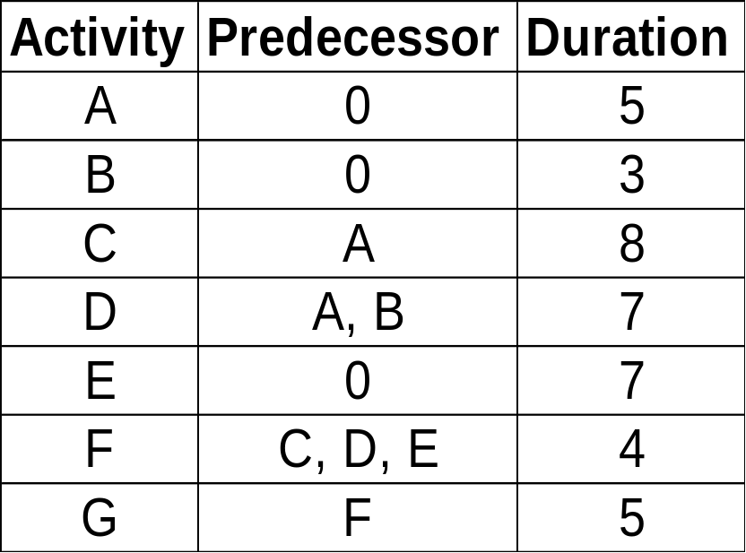
Critical Path Method - Example

Slide 8
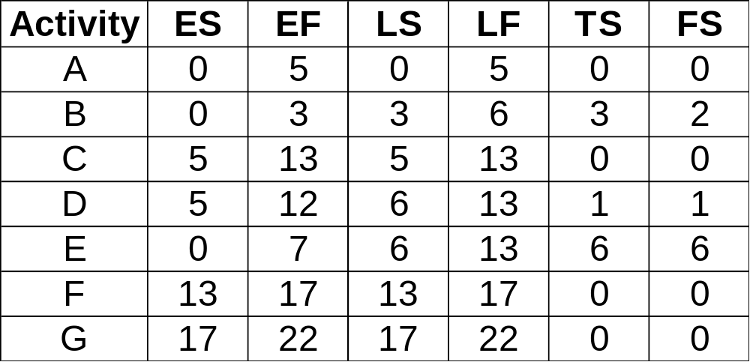
Critical Path Method - Example

Slide 9


Slide 10
Determine the following
  Early start, early finish
  Late start, late finish and slack time
  Critical
Activity | Predecessor | Duration
A | 0 | 3
B | 0 | 6
C | 0 | 4
D | A, B, C | 7
E | D, G, H | 2
F | D | 8
G | F | 0
H | G, E | 7
I | F, E | 8
J | H | 4

Slide 11
Software Requirement Engineering

Slide 12
What are Requirements
Requirements are capabilities and conditions to which the system - and more broadly the project must conform
Software requirements express the needs and constraints that are placed upon a software product that contribute to the satisfaction of some real world application

Slide 13
Requirements vs. Requirement Engineering
The descriptions of the
services and constraints
are the requirements
for the system
The process of finding out,
analyzing, documenting
and checking these
services and constraints
is called
requirements engineering

Slide 14
Types of Requirements
Functional Requirements
Non–Functional Requirements

Slide 15
Requirements
Functional requirements describe system services or functions
  Compute sales tax on a purchase
  Update the database on the server ...
Non-functional requirements are constraints on the system or the development process
  Non-functional requirements may be more critical than functional requirements.
  If these are not met, the system is useless!

Slide 16
Non Functional Requirements
Non Functional Requirements
  a non-functional requirement is a requirement that specifies criteria that can be used to judge the operation of a system, rather than specific behaviors.
Functional requirements define what a system is supposed to do and non-functional requirements define how a system is supposed to be.
  Functional requirements are usually in the form of "system shall do <requirement>“
  In contrast, non-functional requirements are in the form of "system shall be <requirement>",

Slide 17
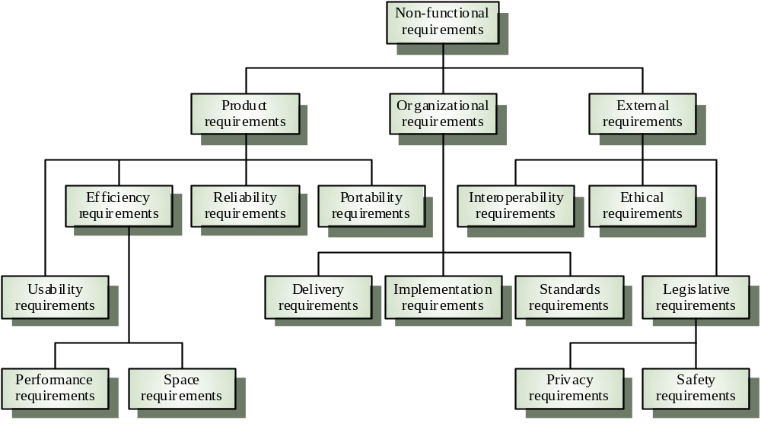
Types of non functional requirements

Slide 18
Steps of Requirement Engineering
Inception
Elicitation
Elaboration
Negotiation
Specification
Validation
Requirement Management

Slide 19
1. Inception
How does a software project get started?
Problem or Opportunity
Mandatory Requirement

Slide 20
2. Requirements Elicitation
Ask your customer and users
What are the objectives of the system and the product
What are the Enterprise Goals to be accomplished
How the system or product fits into the needs of the business
How the system or product is to be used on a day-to-day basis

Slide 21
Difficulties
Problems of Scope
Problems of Understanding
Problems of volatility
To overcome these problems, Requirement gathering
activity must be conducted in an organized manner

Slide 22
Guidelines for Requirements Elicitation
Assess the business and technical feasibility
Identify people who will specify requirements
Define one or more requirements elicitation methods
Involve different people so that requirements are defined from different point of views
Identify ambiguous requirements as candidates for prototyping

Slide 23
3. Elaboration
Focuses on developing various aspects of software function, behavior and information
Driven by use-case scenarios to describe how end users will interact with the system

Slide 24
4. Negotiation
categorizes and organizes requirements
explores each requirement in relation to others
examines requirements for consistency, omissions, and ambiguity
ranks requirements based on the needs of the users

Slide 25
5. Requirements Specification
The term specification means different things to different people
A specification can be a
    Written document
    Graphical model
    Formal mathematical model
    Collection of usage scenarios
    Prototype

Slide 26
6. Requirements Validation
Requirements Validation examines the specification to ensure that
    All system requirements have been stated unambiguously
    Inconsistencies, omissions and errors have been detected and corrected
    The work products conform to the standards established for the process, the product and the project
Requirement Validation Reviews can be conducted to discover
requirements errors. It is also useful to examine each requirement
against a set of checklist questions

Slide 27
7. Requirements Management
Requirements management is a set of activities that help the project team to identify, control, and track requirements and changes to requirements at any time as the project proceeds
<requirement type><requirement #>

Slide 28
Quiz 2
    What is Gantt Chart? Explain the benefit of using Gantt Chart in project management lifecycle.
Determine the following
  Early start, early finish
  Late start, late finish and slack time
  Critical
Write and explain the formula of COCOMO for
estimating initial effort of the project
Activity | Predecessor | Duration
A | 0 | 3
B | 0 | 6
C | E | 4
D | A, B | 7
E | D | 2
F | E, D, C | 8
G | E, F | 0
H | G, F, B | 7
I | G | 8
J | H | 4

Slide 29
Quiz 3
    What is CPM? Explain the purpose of using CPM in project Gantt Chart and discuss the benefit of its use in project management lifecycle.
Determine the following
  Early start, early finish
  Late start, late finish and slack time
  Critical
What are the three types of projects used in computing in the
the initial effort using COCOMO, explain.
Activity | Predecessor | Duration
A | 0 | 3
B | 0 | 6
C | 0 | 4
D | A, B, C | 7
E | D, G, H | 2
F | D | 8
G | F | 0
H | G, E | 7
I | F, E | 8
J | H | 4

